Slide 1
Introduction to Information Security Principles

Slide 2
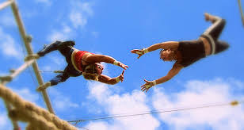
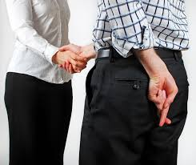
What is Information Security about?
Society is increasingly more reliant on computers
Placing trust on computer applications is a necessity
But are all computer systems trustworthy?
i.e., Do all computer systems deserve our trust?
Trust is placing your confidence in something
Trustworthiness is placing confidence correctly
Trust is belief that a system will operate in an expected manner with attacks causing minimal damage to system and users
Trustworthy systems do operate in an expected manner and resist damage from attacks

Slide 3
What is Information Security about? (cont’d)
Information security studies ways to make systems trustworthy
By assuring a computer system will behave reasonably even in the face of malicious attacks
NIST Cybersecurity Framework
Describes five functions of information security
Identify (system vulnerabilities, risks)
Protect (the system from attacks)
Detect (attacks on the system if they occur)
Respond (to attacks in a reasonable way)
Recover (from attacks to cause minimal damage)
Each function contains outcomes and describes use of standards, guidelines and practices

Slide 4
NIST Function #1: Identify?
Vulnerabilities
Weaknesses in system that expose it to an attack
e.g. using non validated external data allows SQL injection attacks
Threats or attackers
Adversaries who may exploit vulnerabilities
Includes unintentional blunders, hackers, disgruntled employees, organized crime, market competitors, foreign nations
Potential threats vary based on given system
e.g., student grades are unlikely to be targeted by a foreign nation or organized crime
Risk
The expected damage from a security violation.
Includes likelihood of a vulnerability being exploited and cost of damage
e.g. web service may have vulnerability, but if it’s not connected to network, risk is zero
Attack vectors
Describes how attacker could carry out an attack
e.g., malicious email attachment, SQL code injection, tricking human operator

Slide 5
What is Information Security about? (cont’d)
Information security is a process
It is never done! Always trying to improve
How does this relate to the NIST Cybersecurity Framework?
Some examples …
Identify a vulnerability, adjust system to protect it
Detect an attack, respond and recover
Detect an attack, identify attack vector, adjust system to protect it

Slide 6
Cybersecurity is Inter-disciplinary
Information security requires more than just technical knowledge and solutions
E.g., Can technology alone solve social engineering attacks?
Spoofing someone’s email address (phishing attacks)
spoofing a bank’s web-site
How does this relate to the NIST Cybersecurity Framework?
Some examples
Identify a risk, change a company policy (e.g., long-term retention of data)
Detect an attack
What is company’s ethical responsibility for contacting affected individuals?
What is company’s legal responsibility for notifying the public?
What is the economic impact to the company’s suppliers/partners?
Detect an email phishing attack, modify education strategy of employees

Slide 7
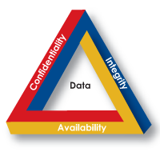
Goals of Security
C.I.A = Confidentiality, Integrity, Availability
Integrity
assurance that data has not been altered in an unauthorized way
Confidentiality protect data from unauthorized disclosure
Availability
assurance that the data/service is accessible to those with access to it

Slide 8
Breaches of C.I.A
Confidentiality Breach
Sensitive information reaches unauthorized persons
Integrity Breach
Data is fraudulent or altered without authority
Breaches of availability
Losing access to services
Which security goal is violated?
A student’s private discussions with counselor is revealed to a teacher.
A malicious attacker changes the passwords of valid users, preventing them from accessing the site.
A request to transfer $100 from account is changed by attacker to $10,000.
An email that looks like it is from your bank but in fact is a phishing attack
A student’s records are released without obtaining student’s permission.
Not being able to access a web site if it is under a denial of service attack
C
A
I
I
C
A

Slide 9
Balancing C.I.A
C.I.A goals are at odds with one another and must be balanced
Increasing availability usually decreases confidentiality and integrity
Example 1: Lockout a user’s account after several failed password attempts.
Good for confidentiality and data integrity, bad for availability
Is this a good security policy?
Yes for some settings (e.g., email)
No for others (e.g., medical records systems)

Slide 10
Balancing C.I.A (cont’d)
C.I.A goals are at odds with one another and must be balanced
Increasing availability usually decreases confidentiality and integrity
Example 2: Allow users to do queries over a population (e.g. find the average salary of Le Moyne Employees)
Good for availability and integrity, bad for confidentiality
Queries over a small population can reveal good estimates of salary of one person

Slide 11
Group Discussion (Balancing CIA)
How are security goals C.I.A being traded off below?
Students are only informed of the average grade of a homework assignment only if more than 10 students submitted it.

Slide 12
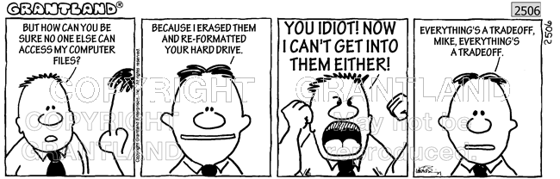
Perfect Security?
Since C.I.A goals are often at odds it is impossible to design systems with perfect security
Our goal is to minimize risk and to be aware (as much as is possible) of the risks that remain

Slide 13
Security Concepts that Support Trust (A.A.A.Nr)
Assurance
How trust is managed
Policies (i.e., behavioral expectations)
Permissions (i.e., behaviors allowed by agents)
Protections (i.e., mechanisms to enforce policies and permissions)
Authenticity
Ability to determine that statements, policies, and permissions are genuine
e.g. ATM card and pin authenticates that you have right to make a withdrawal from your account
Anonymity
Not possible to attribute certain records or transactions to any individual
Non-repudiation (++)
Someone cannot deny something
i.e., a user should be responsible for their actions and should not be able to deny what they have done

Slide 14
How to Authenticate?
Authenticate
Determine if statements, policies, and permissions are genuine
Authentication can be done based on
Something you know
e.g., PIN, password, mother's maiden name
Something you have
e.g., a driver's license, magnetic swipe card, car keys
Something you are
e.g., biometrics (fingerprints, retina scans, etc.)

Slide 15
Breaches in A.A.A.Nr
In each scenario describe which concept authentication, assurance and anonymity is breached .
An individual under 21 uses a fake ID to get into a bar and buy alcohol.
A wait staff takes a customer’s order. When the order is ready, the customer’s name is called and they must walk over to the bar to pick up their order.
An individual under 21 goes into a bar and is asked to wear a green band to indicate that they are not allowed to purchase alcohol. The bar is crowded and the bartender misses the green band and allows the individual to purchase alcohol.

Slide 16
Class Discussions (Cybersecurity is inter-disciplinary)
You work at a software company and discover a new vulnerability in an application that is already deployed. Should this be disclosed?
What are some ethical reasons to disclose?
What are some ethical reasons not to disclose?
San Bernardino case: FBI had iPhone of suspected shooter
FBI could not access data on device (it’s data was encrypted)
Apple did not want to help FBI (by disabling its password policy)
i.e., after 10 unsuccessful password attempts the device is locked
What arguments are in favor of the FBI?
What arguments are in favor of Apple’s position?

Slide 17
Group Work
Conduct a security review of one of the following scenarios by identifying
one vulnerability
threats or attackers for that vulnerability
attack vectors (i.e. how an attack would be carried out by attacker)
how risky the vulnerability is
at least one entity we trust to not take advantage of the vulnerability
at least one possible way to mitigate the vulnerability even if entity is untrustworthy
Paying with Credit Card at Restaurant – At a sit down restaurant the waiter/waitress brings your bill, you hand over your credit card, the card is taken to the register to ring up your order and brought back to you in approximately 5 minutes.
Turkey Trot – You and your cousin decide to run in this year’s turkey trot (good for you!). You can register online up to 3 months prior to the race. On the morning of the race, pre-registered individuals tell the race officer their name. The race officer checks the list of pre-registrants to make sure the name is on a list, and hands over the race bib.

